Slide 1
UCSD Embedded RTOS Assignment 4
By
Hsuankai Chang
hsuankac@umich.edu

Slide 2
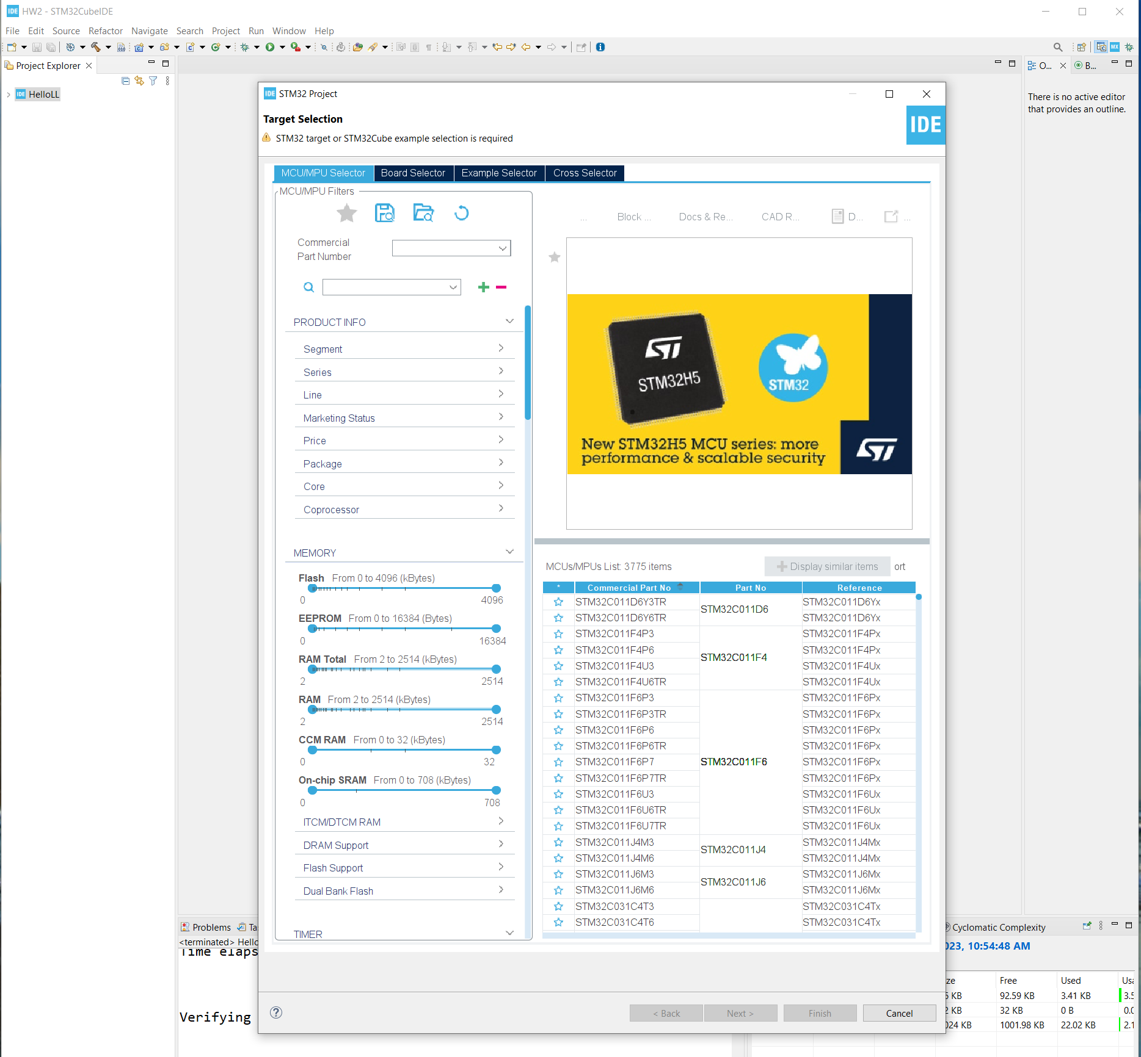
Step 1. Startup STM32CubeIDE and create new STM32 project

Slide 3
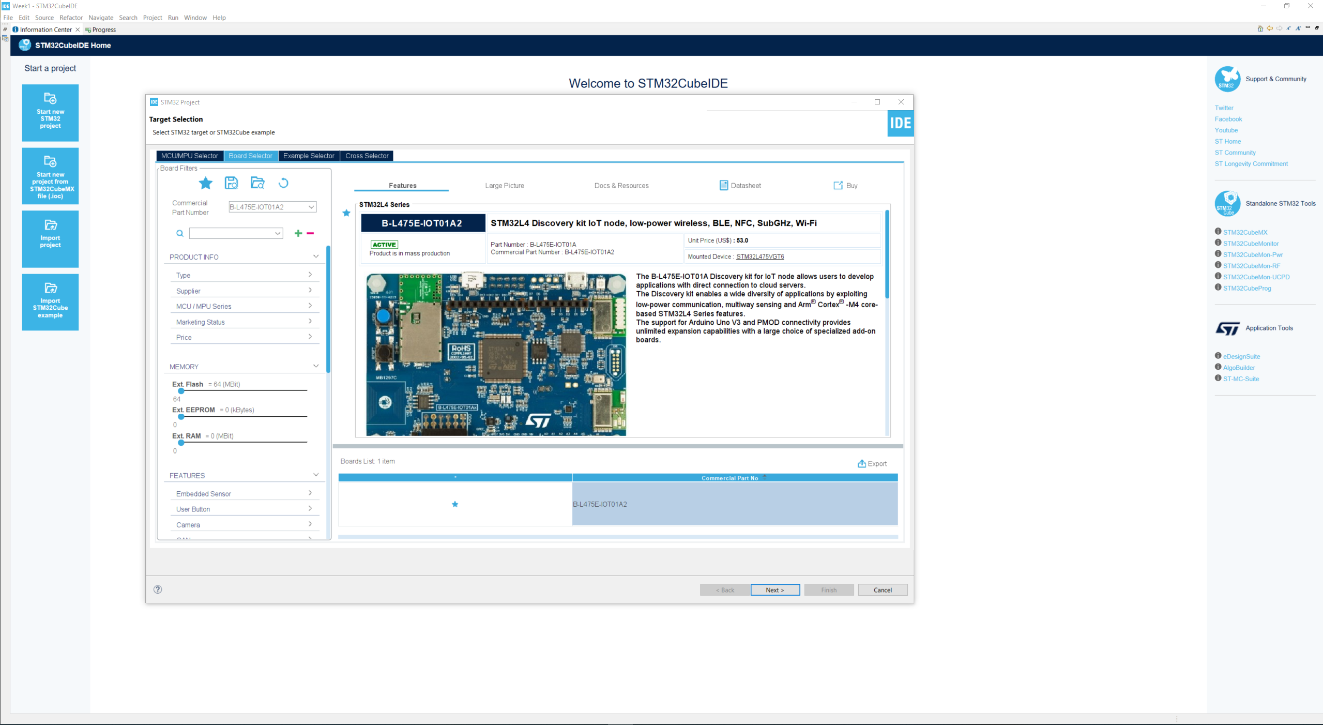
Step 2. Access board selector and type in the board you use, click Next

Slide 4
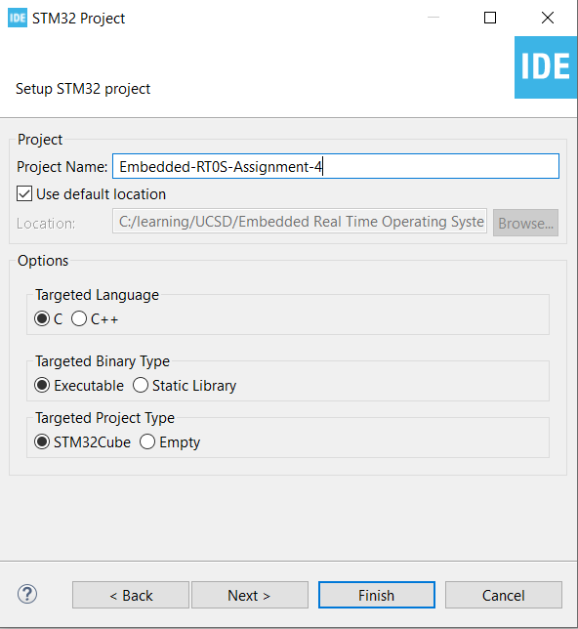
Step 3. Enter the project name then click Next

Slide 5
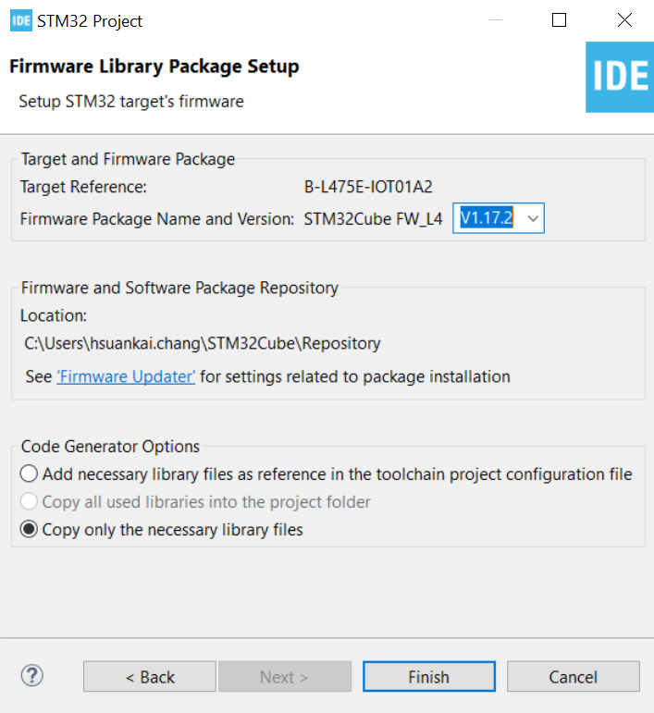
Step 4. See the firmware package name and version

Slide 6
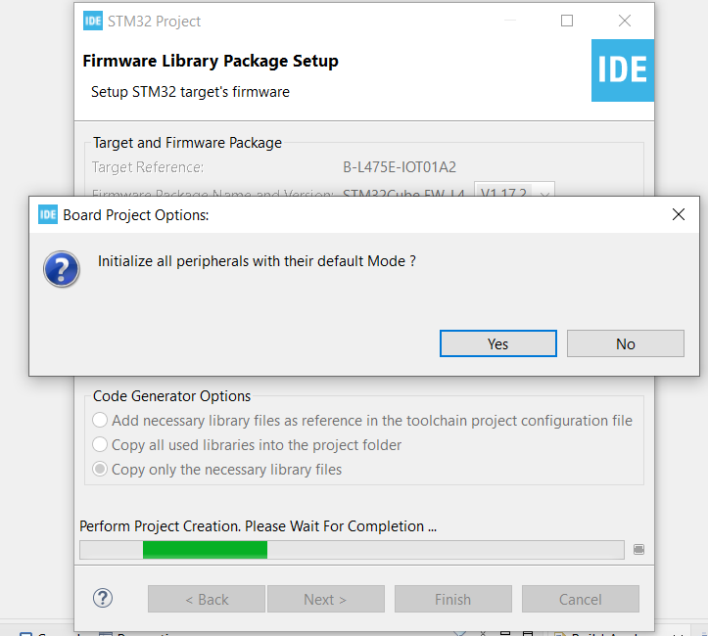
Step 5. Click yes to initialize all peripherals to default

Slide 7
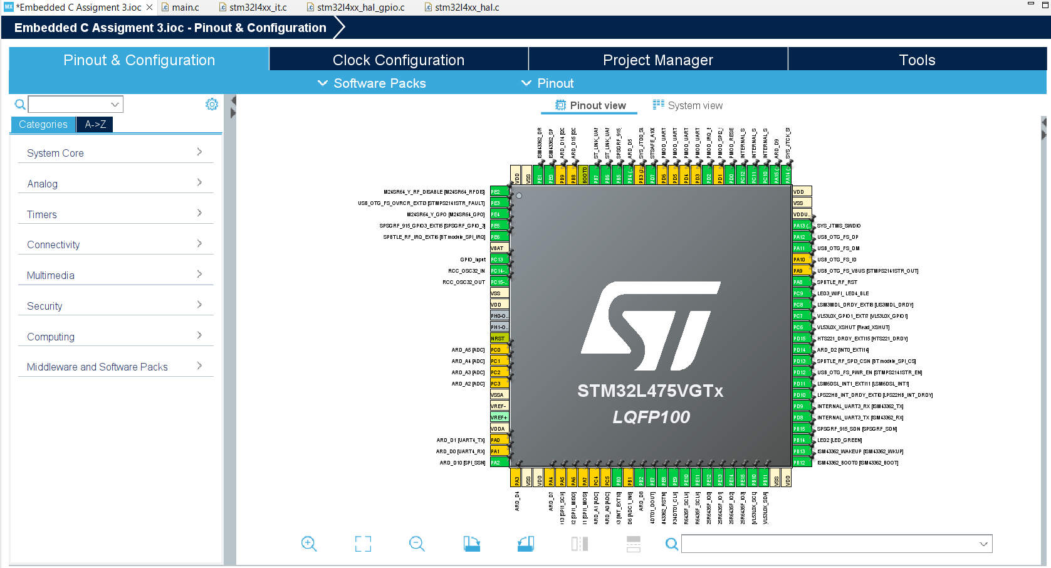
Step 6. When in .ioc file, click Pinout & Configurations

Slide 8
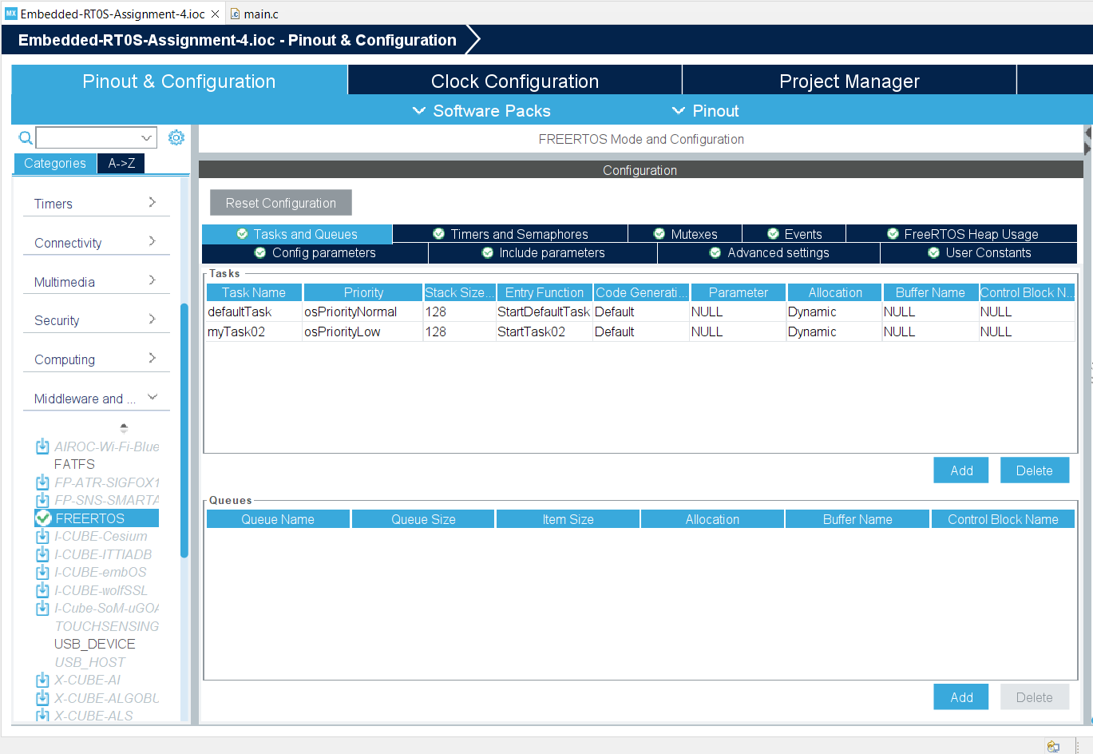
Step 7. Enable the CMSIS_V1 RTOS, and add one more tasks.

Slide 9
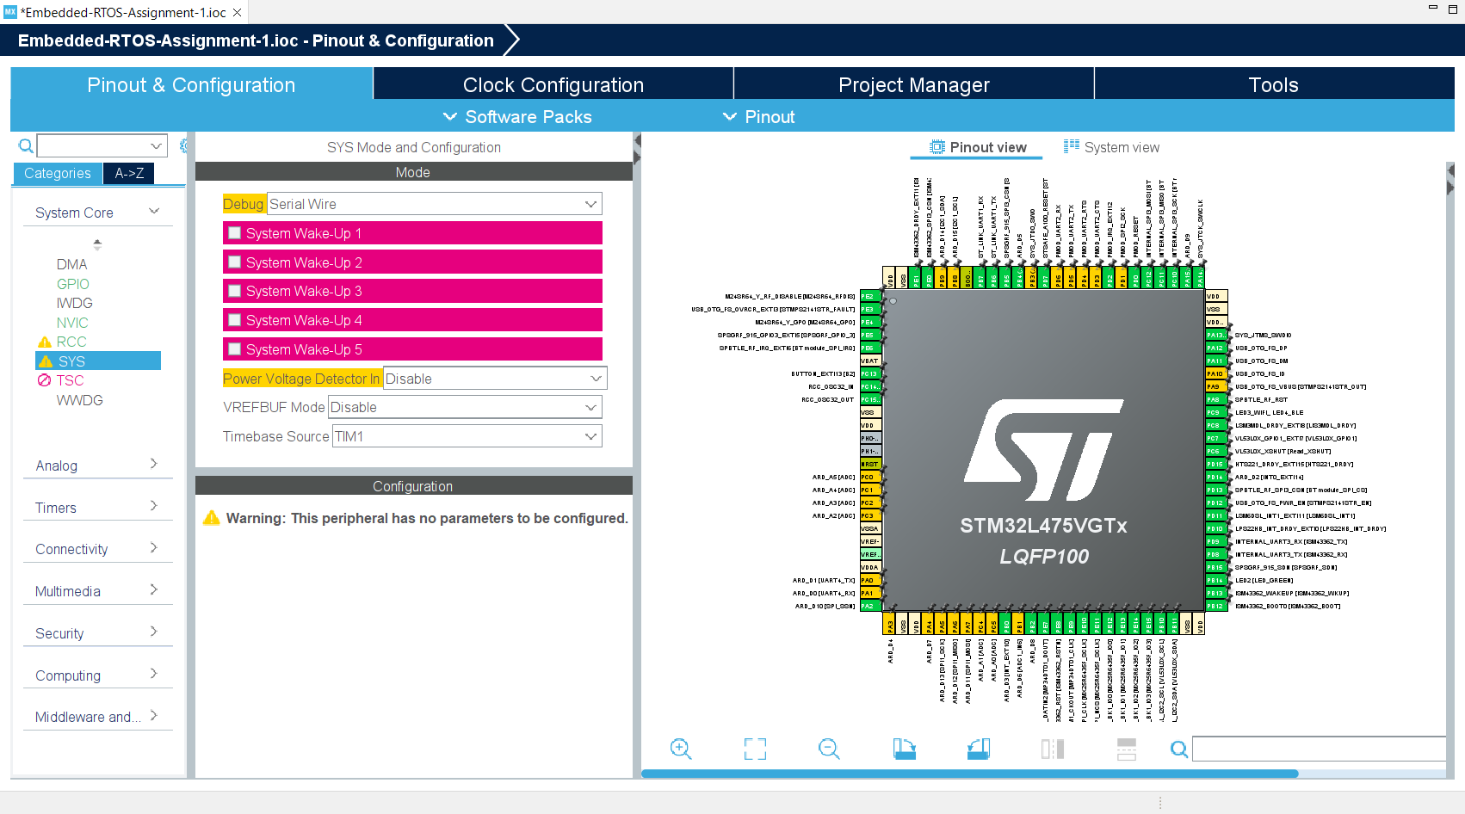
Step 8. Change Timebase from systick to TIM1

Slide 10
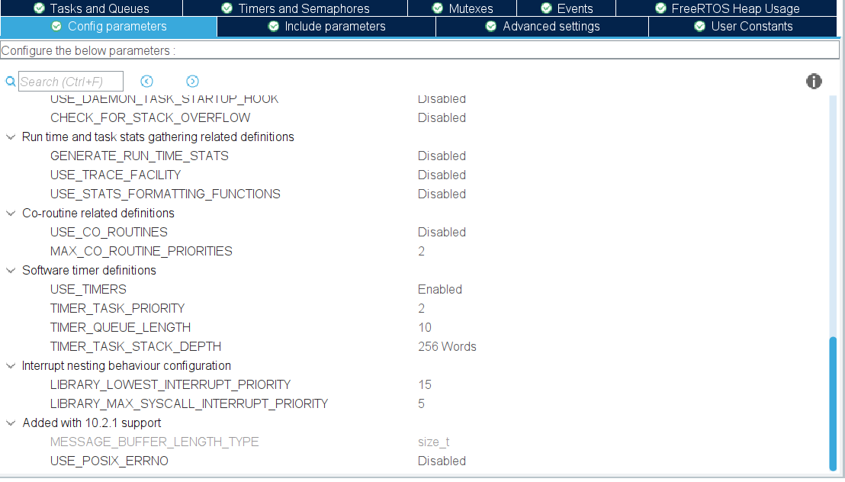
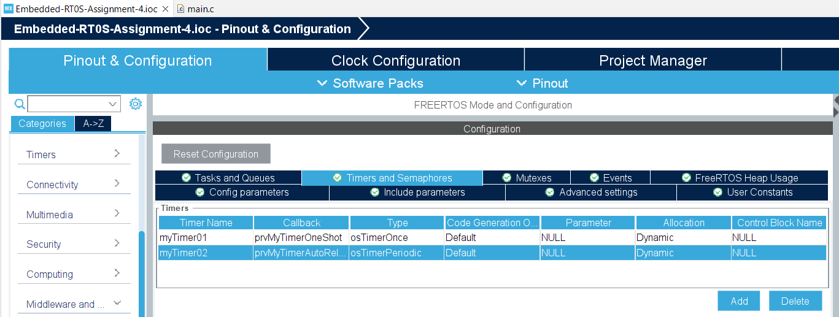
Step 9. Enable the software timer in FreeRTOS settings and add two more timers. One one-shot timer and one auto reload timer

Slide 11
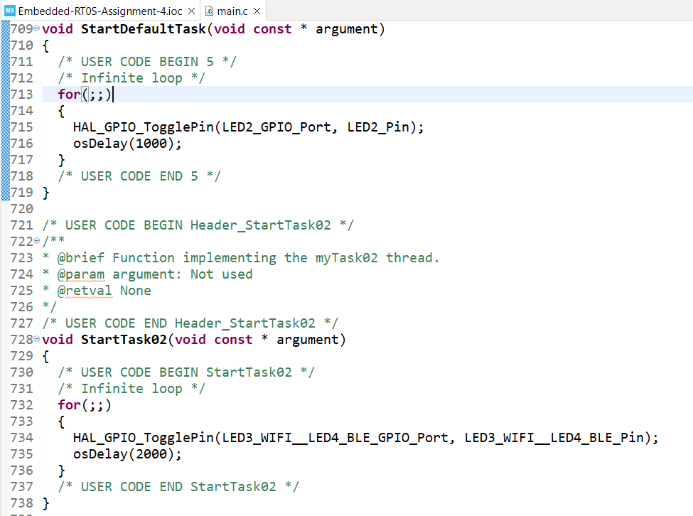
Step 10. Create "Task 1" that blinks the LED2 at a rate of 1 second. Create "Task 2" that blinks the "Wifi/BLE" LED at a rate of 2 seconds

Slide 12
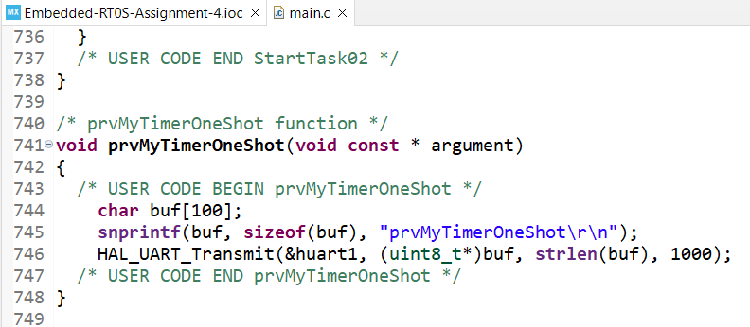
Step 11. Create "Timer 1" that is a One-Shot timer function named prvMyTimerOneShot(). The timer should fire 15 seconds after startup and display a message "prvMyTimerOneShot" on the console.

Slide 13
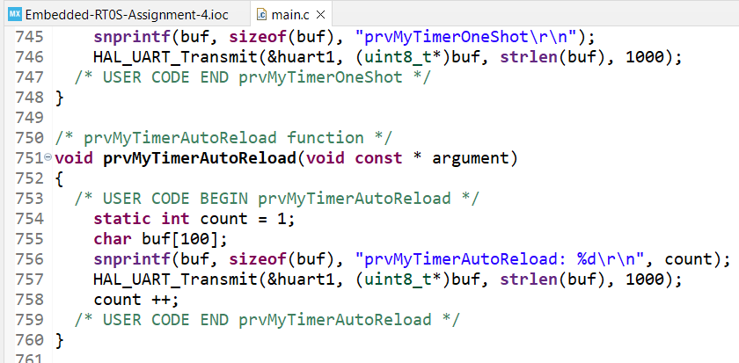
Step 12. Create "Timer 2" that is an auto-reload timer function named prvMyTimerAutoReload(). The timer should fire every 5 seconds and display a count and a message on the console, for example, "prvMyTimerAutoReload: 1".

Slide 14
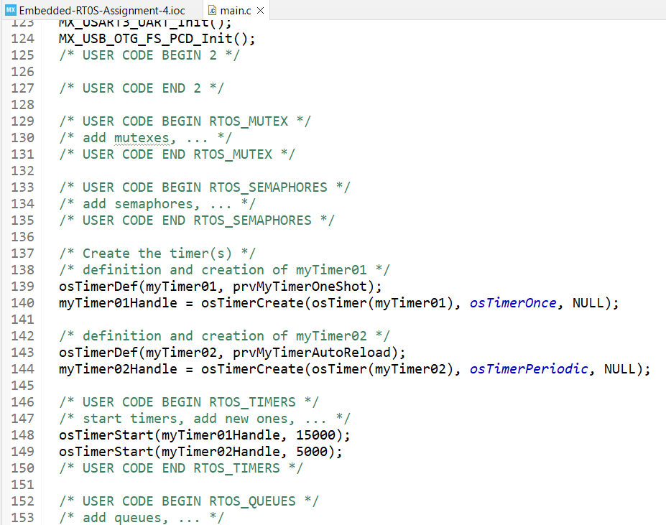
Step 13. Don’t forget to start the timer and set the timing parameter

Slide 15
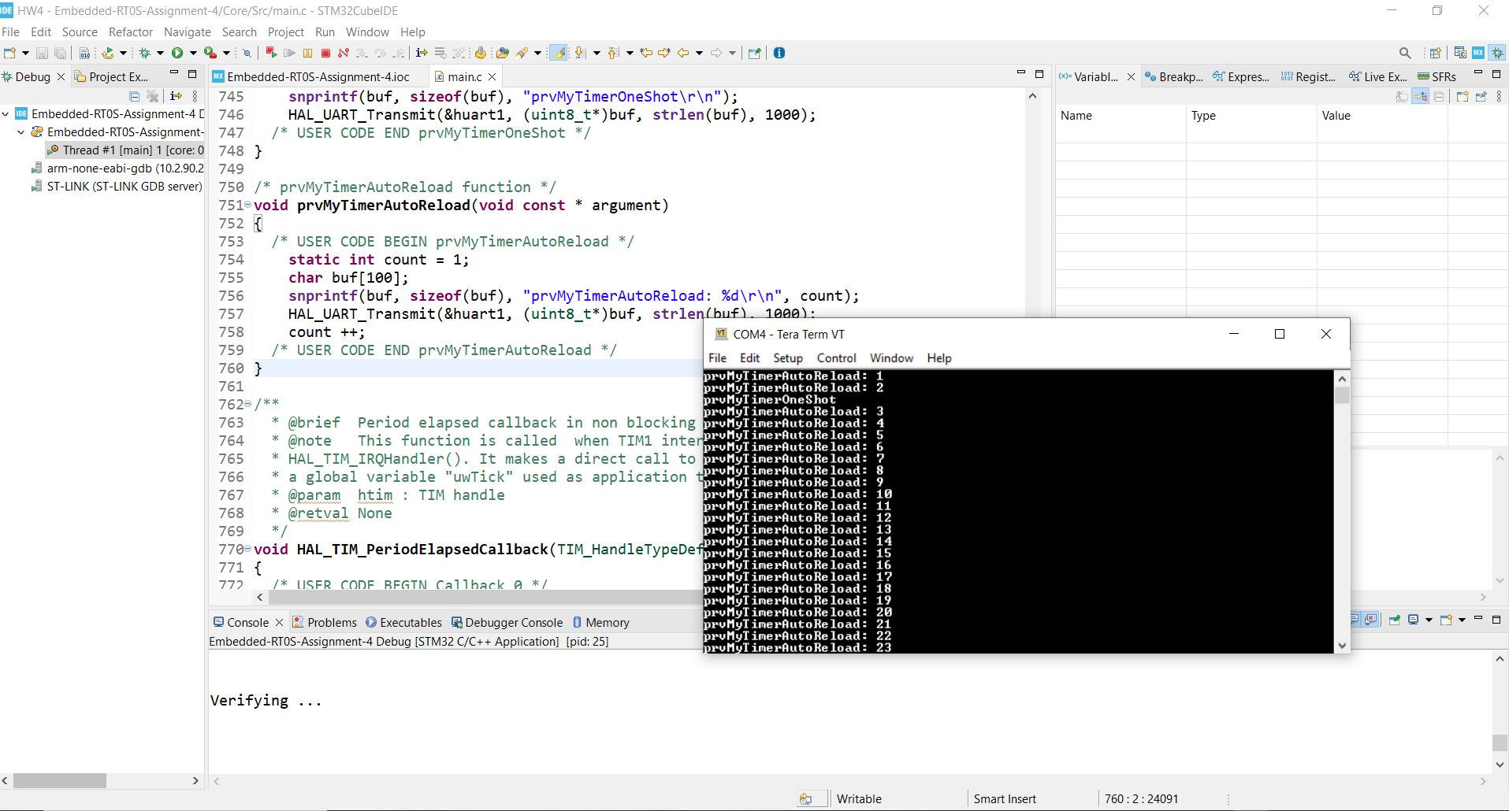
Step 14. Debug and run the code, test is successful

